Slide 1
DISCIPLESHIP? Another Look
Cornerstone Class
January 29, 2017
Prepared by Bob Young
www.bobyoungresources.com

Slide 2
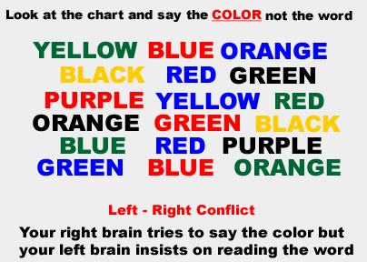

Slide 3
SEE HOW EASY IT IS!
g g g
g g g
g g g
g g g
g g g
g g g

Slide 4
ALL TOGETHER!
g g g
g g g
g g g
g g g
g g g
g g g

Slide 5

Disciple? What comes to your mind?
www.bobyoungresources.com

Slide 6
Teacher and Student
Master, disciple
Teacher, learner
Matthew 11:28-30
Follower of master’s teachings
The disciple is like the master
www.bobyoungresources.com

Slide 7

What does a disciple learn?
ETHICS
VALUES
PRINCIPLES
www.bobyoungresources.com

Slide 8
Three Words to Guide Us
Discipleship is….
Disciplined
Intentional
Unhesitating
www.bobyoungresources.com

Slide 9

Discipleship: A “Centered” Life

Slide 10
What are the essentials of my life?
Centered on God—heart of worship—my purpose
Relationships
Family
Friends
Others
Stewardship
Self
Stuff
Situation
How I live my life
Stretching
Sabbath-ing
Serving

Slide 11
Take-aways
Seeing discipleship as a “centered life”
This is how I pray
This is my decision-making
This is how I live
www.bobyoungresources.com

